Slide 1

DGS General Coding Guideline

Slide 2
Agenda
5.6 C−Functions and SW−Services
5.7 Design patterns to avoid multiple write
5.9 Coding Guideline for arithmetic services
2
RBVH/EJV3 | 2018-05-28
© Robert Bosch Engineering and Business Solutions Vietnam Company Limited 2018. All rights reserved, also regarding any disposal, exploitation, reproduction, editing, distribution, as well as in the event of applications for industrial property rights.

Slide 3
5.6 C−Functions and SW−Services
3
RBVH/EJV3 | 2018-05-28
© Robert Bosch Engineering and Business Solutions Vietnam Company Limited 2018. All rights reserved, also regarding any disposal, exploitation, reproduction, editing, distribution, as well as in the event of applications for industrial property rights.

Slide 4
Deﬁnition and declarations of C−functions
5.6 C−Functions and SW−Services
C−functions shall be deﬁned in the *.c−ﬁle of a component, if not deﬁned as inline functions.
For each C−function which is provided to external a prototype shall be provided in a *.h ﬁle.
Inline functions which are used public (in the interface) shall be deﬁned in header ﬁles
C−functions shall be described in PaVaSt
4
RBVH/EJV33 | 2018-05-28
© Robert Bosch Engineering and Business Solutions Vietnam Company Limited 2018. All rights reserved, also regarding any disposal, exploitation, reproduction, editing, distribution, as well as in the event of applications for industrial property rights.

Slide 5
Deﬁnition and declarations of C−functions (cont.)
5.6 C−Functions and SW−Services
Currently the MEDC17 and MDG1 tool chain does not create prototypes from the PaVaSt information into the generated component headers. This means that the header ﬁle has to be provided additionally to the generated component header. The name and the way how the header is deﬁned depends on the header ﬁle concept which is applied.
The prototype shall be given according to the MISRA Standard.
Prototypes are not required for locally deﬁned and used C−functions(sub−routines) and inline functions. On the other hand side all information about C−functions (SW_SERVICES) shall be given in PaVaSt for proper processing of the message concept and MCOP.
Describe the usage of the function / service just above the function deﬁnition in *.c ﬁle. Also mention if there is any special note regarding the usage of the function / service.
5
RBVH/EJV33 | 2018-05-28
© Robert Bosch Engineering and Business Solutions Vietnam Company Limited 2018. All rights reserved, also regarding any disposal, exploitation, reproduction, editing, distribution, as well as in the event of applications for industrial property rights.

Slide 6
Services and APIs are re−entrant
5.6 C−Functions and SW−Services
Re−entrant deﬁnition (single core): A function is re−entrant if it can be interrupted somewhere in its execution and then safely called again before its previous invocation completes executing, produce correct results for both invocations.
Re−entrant deﬁnition (multi core): A function is re−entrant if it can be called on one core while it is already executing on any other core and still produce correct results for all calls
“All services and APIs shall be multicore re−entrant.”
6
RBVH/EJV33 | 2018-05-28
© Robert Bosch Engineering and Business Solutions Vietnam Company Limited 2018. All rights reserved, also regarding any disposal, exploitation, reproduction, editing, distribution, as well as in the event of applications for industrial property rights.

Slide 7
Services and APIs are re−entrant (cont.)
5.6 C−Functions and SW−Services
Consequence:
Must not use any static / global variable without resource protection (lock) if data consistency is required. Accesses from services (APIs), processes and especially interrupt routines have to be considered.
No assumptions about priorities and scheduling possible (e.g. for interrupt code)
Must not modify its own code
Must not call other non re−entrant functions
7
RBVH/EJV33 | 2018-05-28
© Robert Bosch Engineering and Business Solutions Vietnam Company Limited 2018. All rights reserved, also regarding any disposal, exploitation, reproduction, editing, distribution, as well as in the event of applications for industrial property rights.

Slide 8
Services and APIs are re−entrant (cont.)
5.6 C−Functions and SW−Services
Non re-entrant code:
sint32 a = 1;
sint32 foo(void)
{
a += 2;
return a;
}
sint32 bar(void)
{
return (foo() * 10);
}
Same functionality re-entrant:
sint32 a = 1;
sint32 foo(sint32 a)
{
return (a + 2);
}
sint32 bar(sint32 a)
{
return (foo(a) * 10);
}
8
RBVH/EJV33 | 2018-05-28
© Robert Bosch Engineering and Business Solutions Vietnam Company Limited 2018. All rights reserved, also regarding any disposal, exploitation, reproduction, editing, distribution, as well as in the event of applications for industrial property rights.

Slide 9
5.7 Design patterns to avoid multiple write
9
RBVH/EJV3 | 2018-05-28
© Robert Bosch Engineering and Business Solutions Vietnam Company Limited 2018. All rights reserved, also regarding any disposal, exploitation, reproduction, editing, distribution, as well as in the event of applications for industrial property rights.

Slide 10
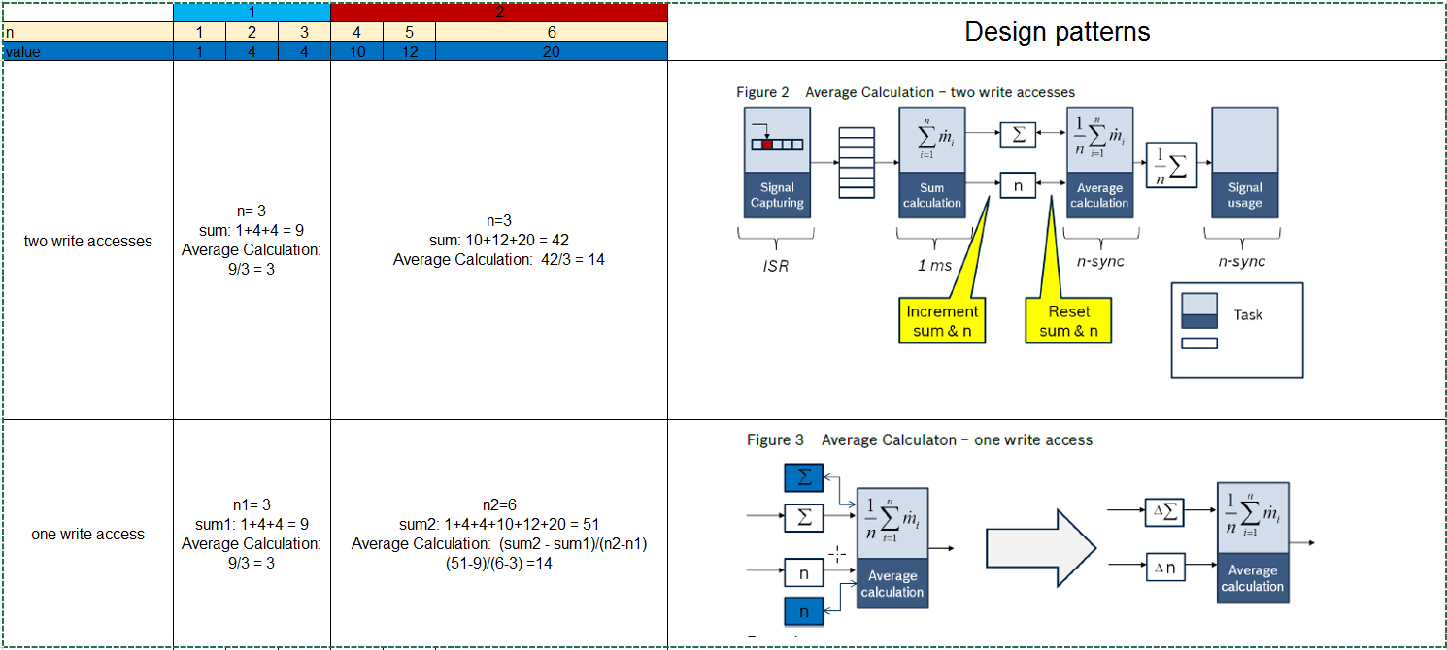
Average Calculation
10
RBVH/EJV3 | 2018-05-28
© Robert Bosch Engineering and Business Solutions Vietnam Company Limited 2018. All rights reserved, also regarding any disposal, exploitation, reproduction, editing, distribution, as well as in the event of applications for industrial property rights.

Slide 11
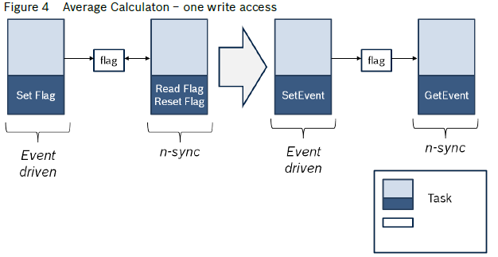
Set/Reset
Instruction The described design pattern should be applied instead of setting/resetting of flags if the functional conditions are like
described.
Often only the information is needed that an event happened. This can be expressed by setting/resetting of flags with the disadvantage that the flag is written two times. It is also possible to consider "counter difference". This means the events are counted and the final count is stored on a local variable. In the next cycle the current count is compared to the old count
11
RBVH/EJV3 | 2018-05-28
© Robert Bosch Engineering and Business Solutions Vietnam Company Limited 2018. All rights reserved, also regarding any disposal, exploitation, reproduction, editing, distribution, as well as in the event of applications for industrial property rights.

Slide 12
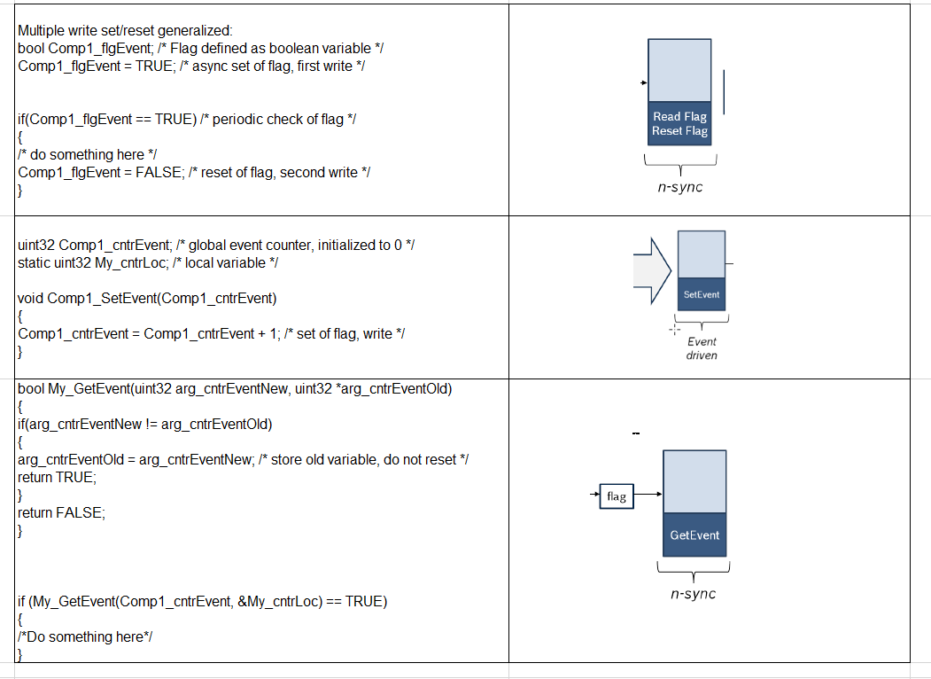
Set/Reset
12
RBVH/EJV3 | 2018-05-28
© Robert Bosch Engineering and Business Solutions Vietnam Company Limited 2018. All rights reserved, also regarding any disposal, exploitation, reproduction, editing, distribution, as well as in the event of applications for industrial property rights.

Slide 13
5.9 Coding Guideline for arithmetic services
13
RBVH/EJV3 | 2018-05-28
© Robert Bosch Engineering and Business Solutions Vietnam Company Limited 2018. All rights reserved, also regarding any disposal, exploitation, reproduction, editing, distribution, as well as in the event of applications for industrial property rights.

Slide 14
Use of the service library
5.9 Coding Guideline for arithmetic services
Instruction: Every use of a service of the services library shall be conform to the description and examples of the programmer's guide documentation.
More information can be found on the Intranet page of the service library: Srv home page.
http://www.intranet.bosch.com/dgs/me_d-edc-17/platform/core/44_services/06_documentation/index.html
The programmers guides which belong to the services can be found below the deliveries pages. Every delivery has its own programmers guide for all the packages SrvB, SrvX and SrvF (Basic services, extended services, and float services.
14
RBVH/EJV3 | 2018-05-28
© Robert Bosch Engineering and Business Solutions Vietnam Company Limited 2018. All rights reserved, also regarding any disposal, exploitation, reproduction, editing, distribution, as well as in the event of applications for industrial property rights.

Slide 15
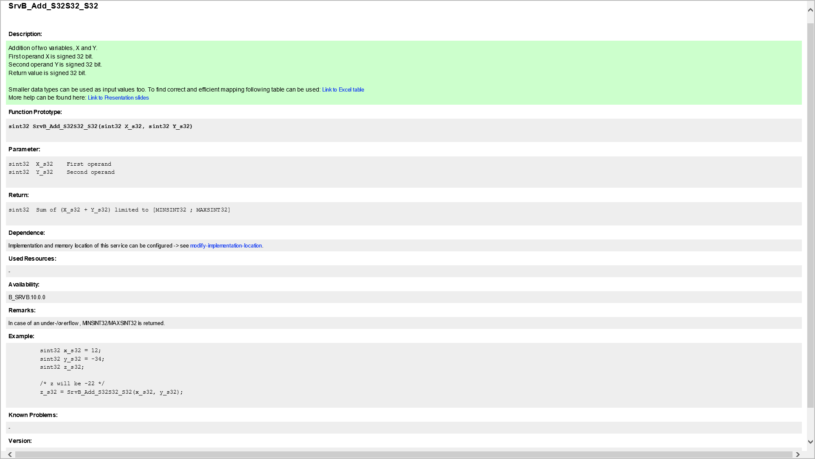
Header of section
15
RBVH/EJV3 | 2018-05-28
© Robert Bosch Engineering and Business Solutions Vietnam Company Limited 2018. All rights reserved, also regarding any disposal, exploitation, reproduction, editing, distribution, as well as in the event of applications for industrial property rights.

Slide 16
Central services with/without side−effect
5.9 Coding Guideline for arithmetic services
Instruction: A service with side−effects shall not be used as right hand operand of a logical && or || operator.
There are some situations in C−code where certain parts of expressions may not be evaluated. If these sub−expressions contain side effects then those side effects may or may not occur, depending on the values of other sub expressions. The operators which can lead to this problem are &&, || and ? .
The operations that cause side−effects are accessing a volatile object, modifying an object, modifying a file, or calling a function that does any of those operations, which cause changes in the state of the execution environment of the calling function
16
RBVH/EJV3 | 2018-05-28
© Robert Bosch Engineering and Business Solutions Vietnam Company Limited 2018. All rights reserved, also regarding any disposal, exploitation, reproduction, editing, distribution, as well as in the event of applications for industrial property rights.

Slide 17
Central services with/without side−effect
5.9 Coding Guideline for arithmetic services
In other words: C−functions which may have side effects are services which write on global variables or which write on parameters passed by address or access a volatile object.
For example:
if ( My_flgHigh && ( y == f( x ) ) ) /* Only acceptable if f( x ) is known to have no side effects */
The list of side−effect free services which are currently maintained in the Cchecker test environment can be are listed in (C:) System Volume > toolbase> ccheckerconfig > <Cchecker Version> > _qac_med17.h.
17
RBVH/EJV3 | 2018-05-28
© Robert Bosch Engineering and Business Solutions Vietnam Company Limited 2018. All rights reserved, also regarding any disposal, exploitation, reproduction, editing, distribution, as well as in the event of applications for industrial property rights.

Slide 18
Thank you for listening!
18
RBVH/EJV3 | 2018-05-28
© Robert Bosch Engineering and Business Solutions Vietnam Company Limited 2018. All rights reserved, also regarding any disposal, exploitation, reproduction, editing, distribution, as well as in the event of applications for industrial property rights.

